Slide 1
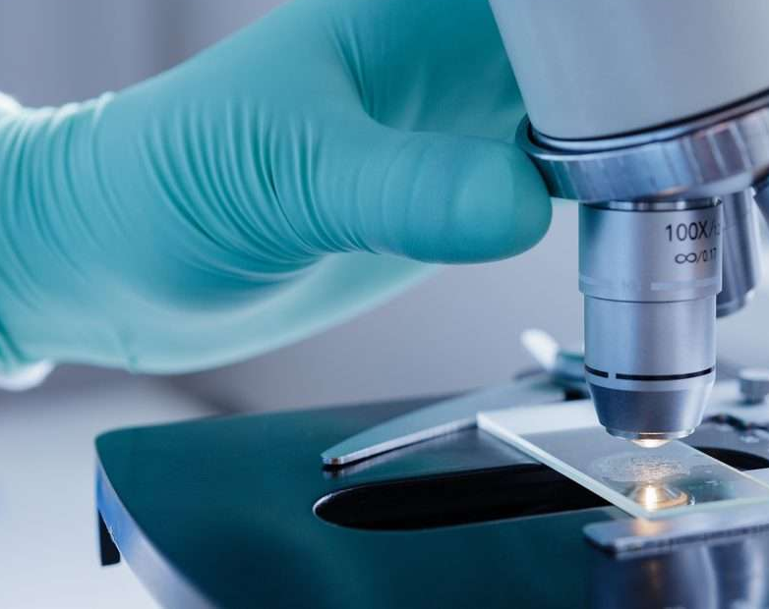
Histopathological Image-Based Cancer Diagnosis Using Tailored CNN models VS transfer learning
Institute of Data
Presenting by Yiting Eva Tan

Slide 2
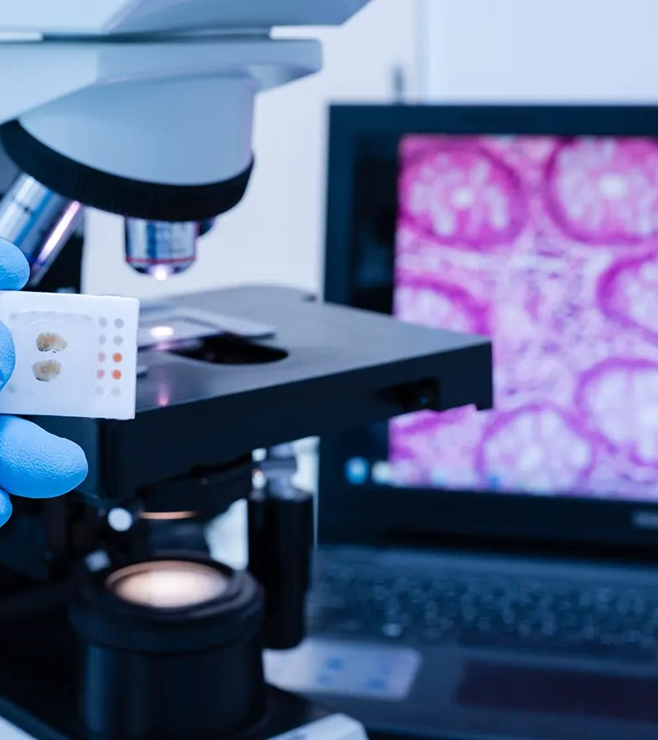
Current challenges & project goal in cancer diagnosis
Key challenges:
Lung and colon cancers are the leading cause of cancer-related deaths worldwide
High volume of manual reviewing slides is time consuming and can potentially increase human error
Lab processing usually takes 1-2 weeks, even longer with special testing
Delays in diagnosis can postpone critical treatment
Project goal:
This project is aim to develop an automated image classification system using Convolutional Neural Networks (CNN) to assist pathologist in the early detection of lung and colon cancer and save cost
Objective:
The objective is to compare performances of custom-built models and pre-trained models to identify the most accurate and efficient solution.

Slide 3
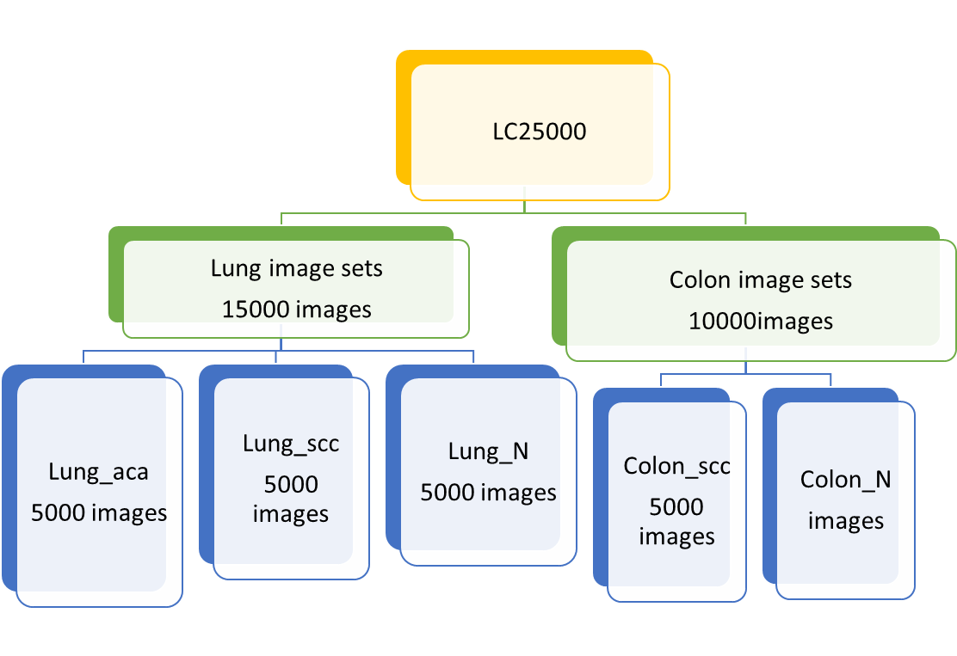
dataset introduction—LC25000
Dataset was downloaded from Kaggle. Images were collected from pathology glass slides at the James A. Haley Veterans’Hospital in Tampa, Florida
25000 histopathological images with 5 classes divided into two subsets –colon and lung images
750 total images of lung tissue (250 benign lung tissue, 250 lung adenocarcinomas, and 250 lung squamous cell carcinomas) augmented to 15000 images
500 total images of colon tissue (250 benign colon tissue and 250 colon squamous cell carcinomas augmented to 10000 images
All images are 768 x 768 pixels in size and are in jpeg file format
All images are Hematoxylin and eosin stained, which is the gold standard stain allowing pathologists to identify progression and type of cancers.

Slide 4
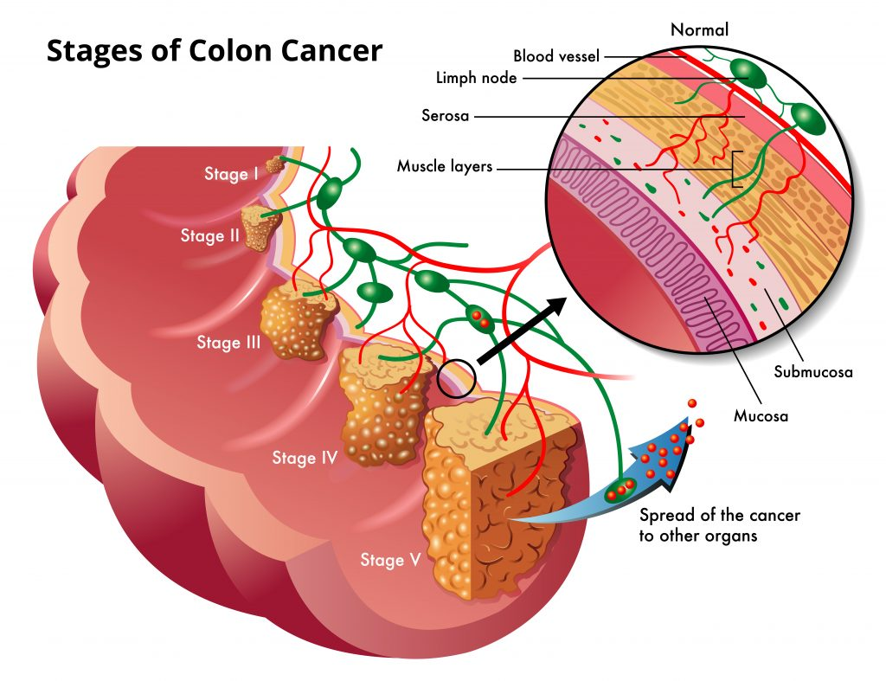
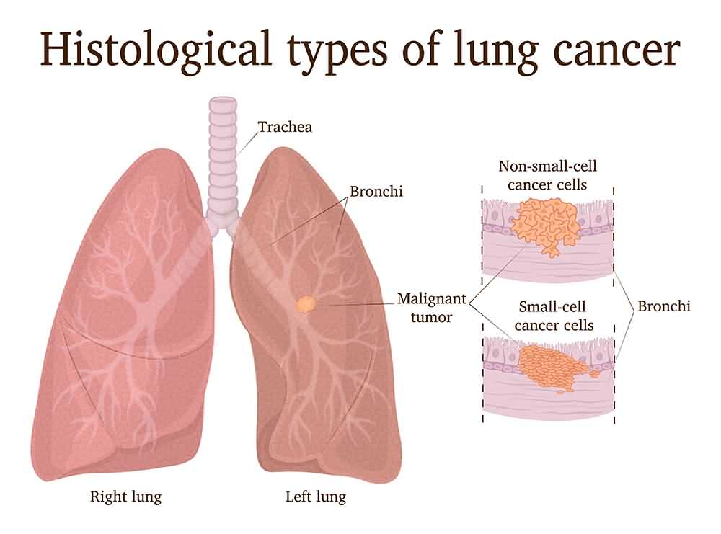
Cancer classifications
Lung_n: lung benign conditions, are non-cancerous growths that are usually harmless and don't spread with early treatment.
Lung_aca: lung adenocarcinoma, the most common type of lung cancer. It originates in the glandular cells of the lungs, often in the outer layers.
Lung_scc: lung squamous cell carcinoma, originates in the squamous cells lining the airways, typically found in the central part of the lungs
Colon_n: colon benign conditions, non-cancerous conditions like colon polyps, inflammatory bowel disease etc. usually not life-threatening.
Colon_scc: colon squamous cell, an aggressive form of colon cancer

Slide 5
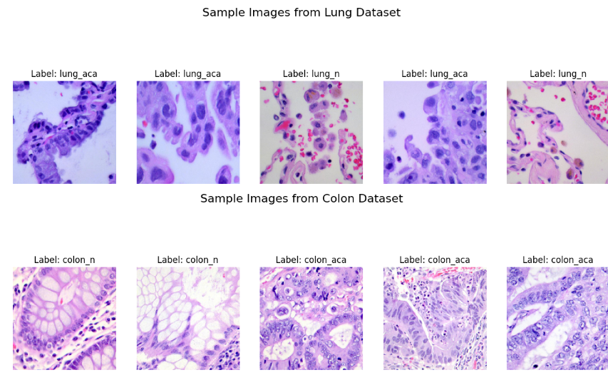
Data preprocessing
Each dataset has been processed into 3 parts. Training(0.7), validation(0.15),test(0.15)
Combined both datasets into one set then divided into train(0.7), validation(0.15), test(0.15)
Images were resized to 180 x 180 pixels and processed in batches of 16 for efficient training for customised models
Pixel values were normalized to a [0,1] scale using a rescaling layer to improve model performance
Class names were extracted directly from the dataset directories to assist with label mapping and predictions

Slide 6
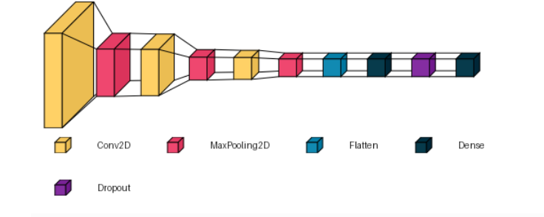
Custom CNN models overview
Composed of three convolutional layers with decreasing filter sizes (256->128->64), each followed by max-pooling2D
Models included a flatten layer followed by a Dense layer(64units) and a dropout layer (0.3) to reduce overfitting
Output layers:
3 neurons (Lung dataset)
2 neurons (Colon Dataset)
5 neurons (combined dataset)
Earlystopping used to prevent overfitting and save training time.

Slide 7
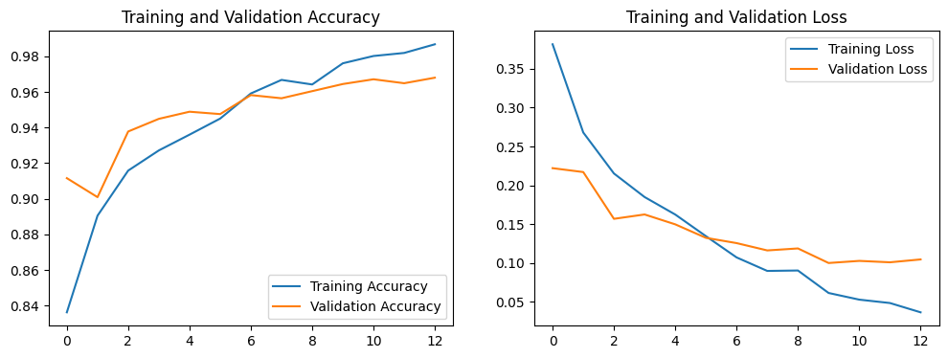
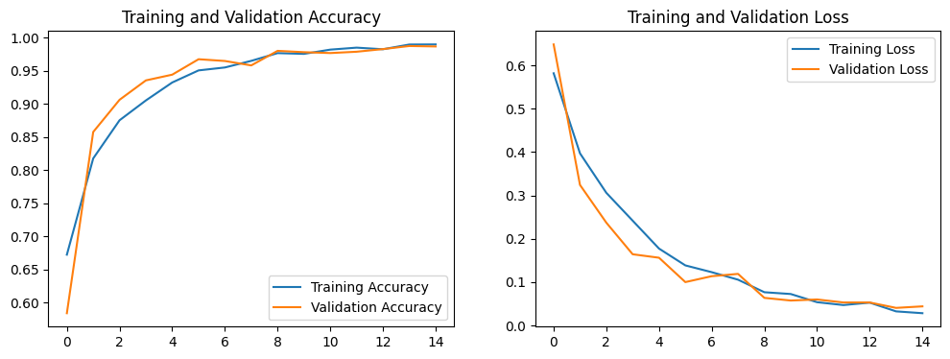
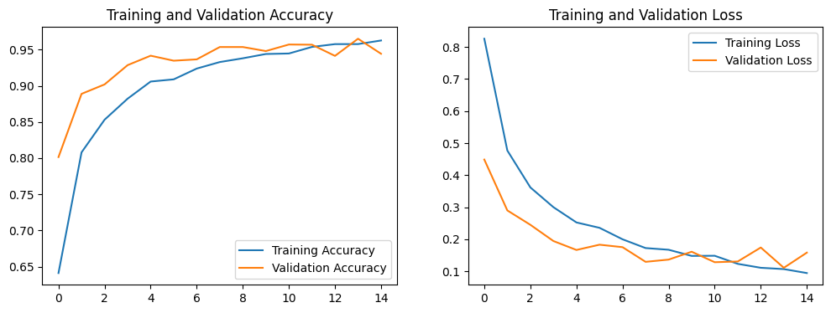
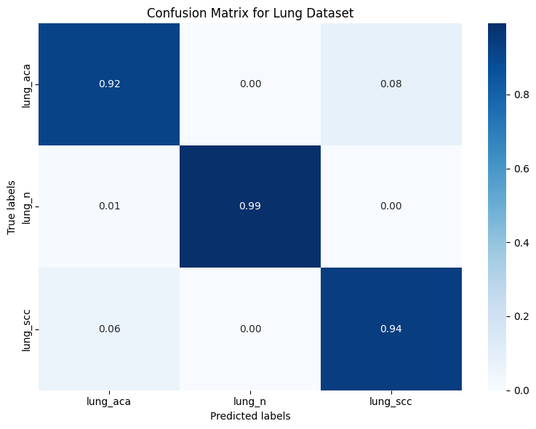
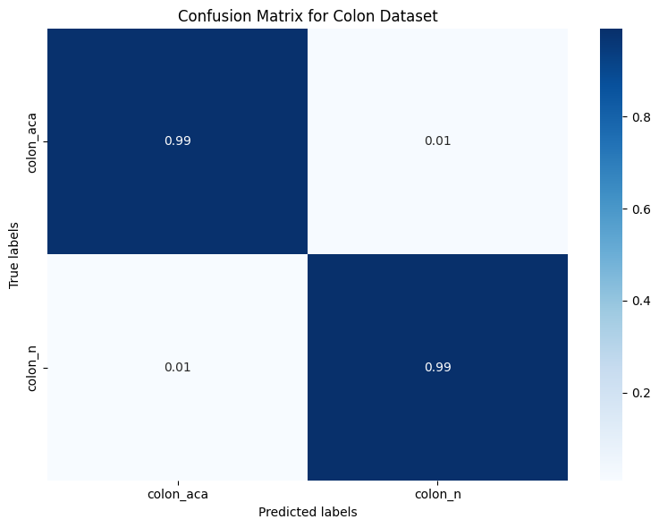
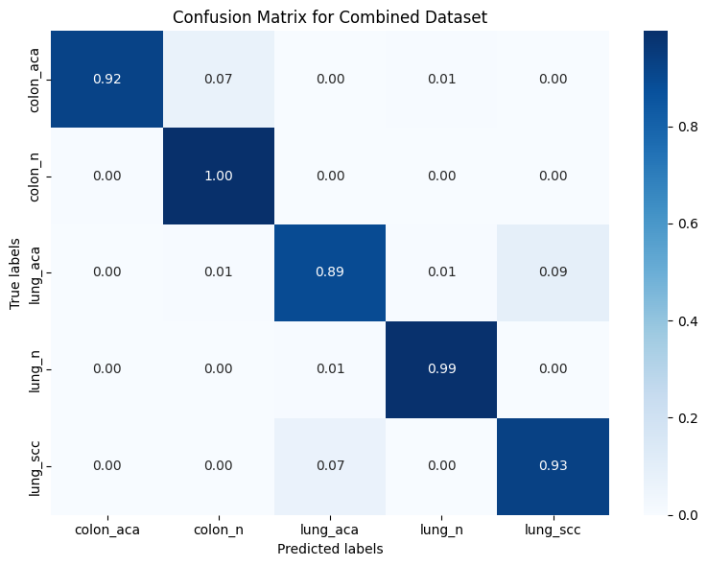
Comparison of performances in each datasets using CNN models from scratch

Slide 8
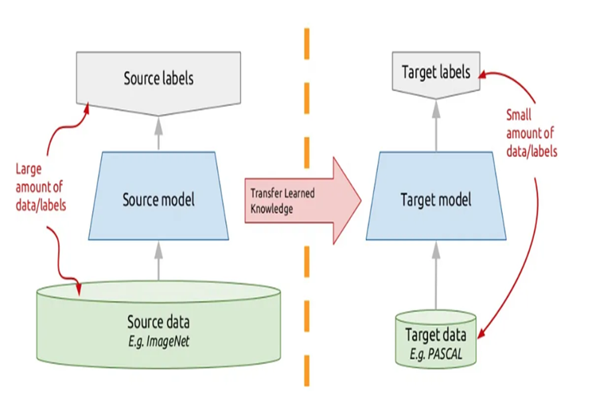
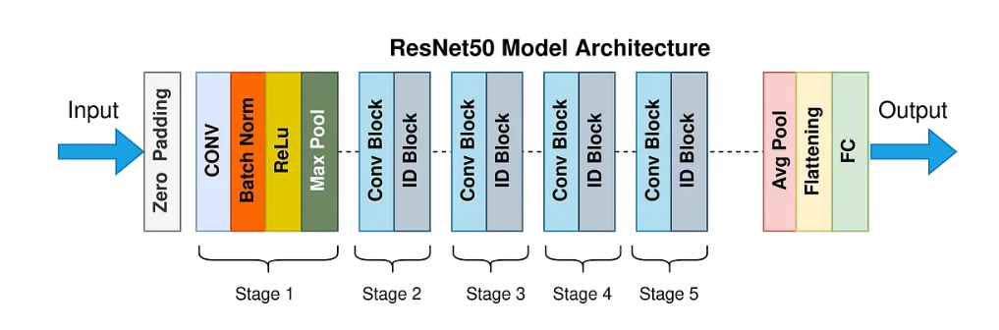
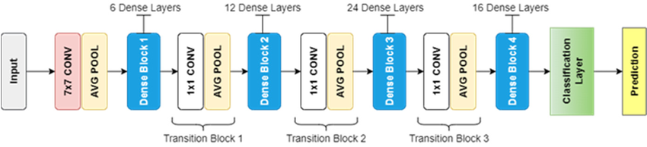
Pretrained models architectures –DenseNet121, ResNet50
Use concept of transfer learning: Pre-trained models have already undergone train with large dataset
Models are used as a starting point for new tasks by using techniques like feature extraction to freeze all convolutional layers and only train a new classifier head.
fine-tuning also applied by unfreezing some top layers and retraining them on the new data to improve adaptability.
The final Classification Layer is replaced with a new fully connected layer for new tasks.
Fine-tuning methods used in training my own data
Input resolution: 280 x 280 pixels
L2 regularization 0.001
Dropout rate: 0.3
Last 30 layers of ResNet50 unfrozen for fine tuning
Adam optimizer used with DenseNet121, SGD with momentum used with ResNet50

Slide 9

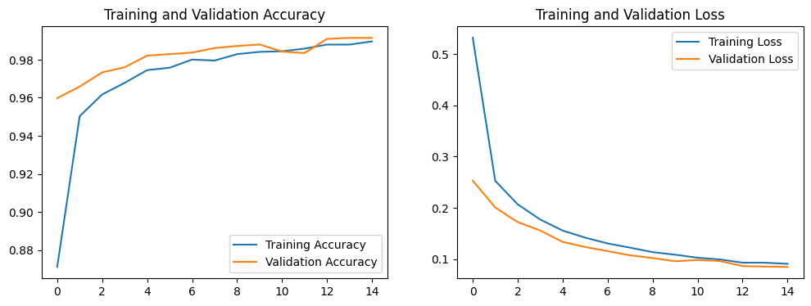
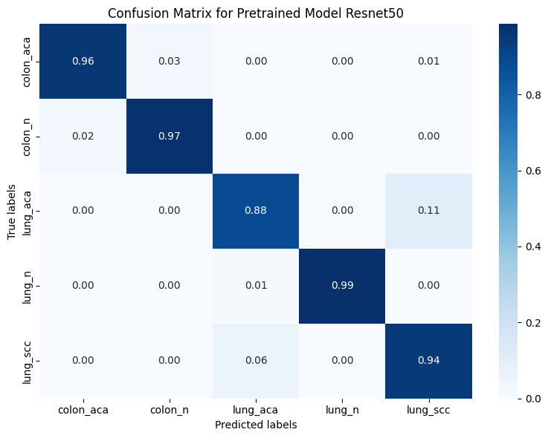
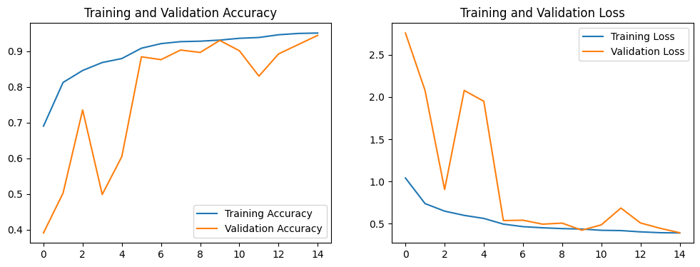
Pretrained model performances
DenseNet121:
100% correctly classified on colon cancers and lung benign conditions.
Only minor confusion between lung_aca and lung_scc, which is due to their common characteristics in both lung cancers.
ResNet50:
High performance but not as good as DenseNet121
Cancer classification requires attention to microscopic details, such as cellular shapes, arrangements, and textures. ResNet50 focuses on global features and might miss these subtle local patterns.

Slide 10
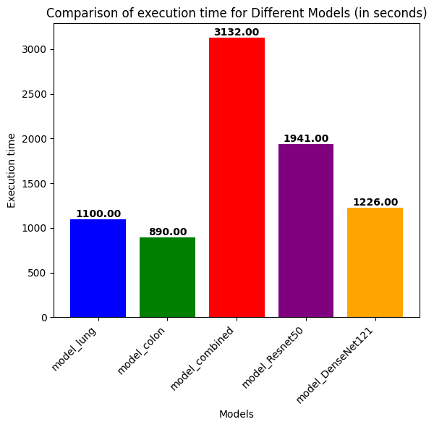
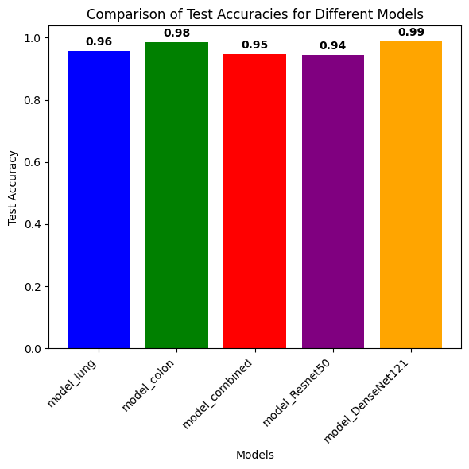
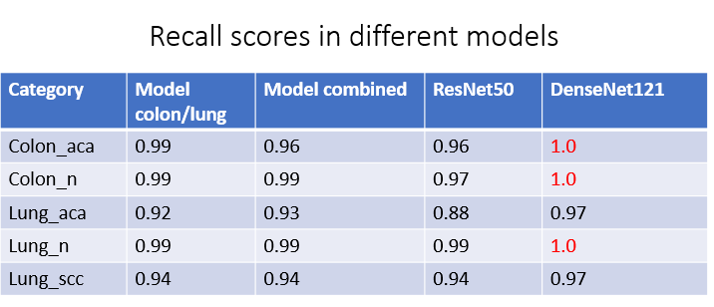
Model performance comparison
The model trained solely on colon images had the shortest execution time.
The combined dataset model had the longest execution time due to larger volume of data.
Comparing models built from scratch to those pre-trained models, the pre-trained generally required less execution time
Recall measures how well the model finds all actual positive cases. High recall is critical in medical diagnosis to minimize false negatives and ensure no cancer cases are missed.
DenseNet121 able to provide best accuracy and recall scores across multiple tissue types, while maintaining low execution time.

Slide 11
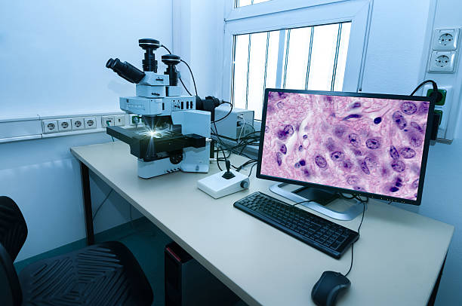
Conclusion and recommendation
Not all pretrained models are suitable for histopathology. Select models that capture textures and cellular structure.
Pre-trained models can significantly reduce training time, computation cost, and dataset size requirement, making it ideal for clinical AI deployment.
Due to similar characteristics of cancer subtypes, the model is only able to use as a tool to filter benign conditions.
Further development
Train models to better distinguish between cancer subtypes
Enhance interpretability to boost trust in clinical testings.
periodically retrain models with new patient data to stay up to date and reduce bias.
For customised model, further fine-tuning or better architecture needed to improve performances for clinical applications.
Making separate models for each type of tissue can significantly increase classification performances

Slide 12
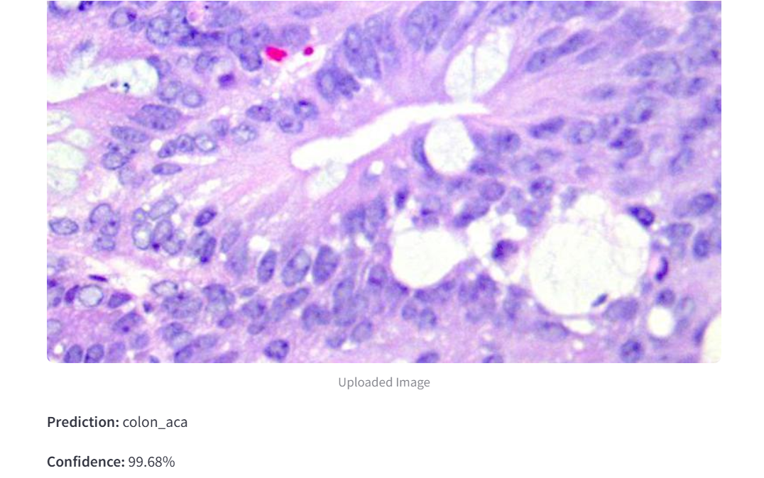
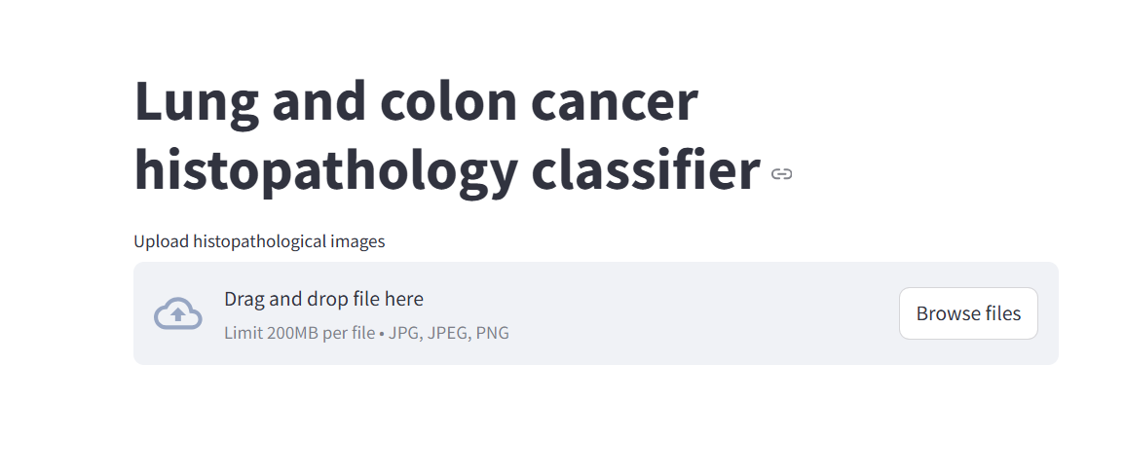
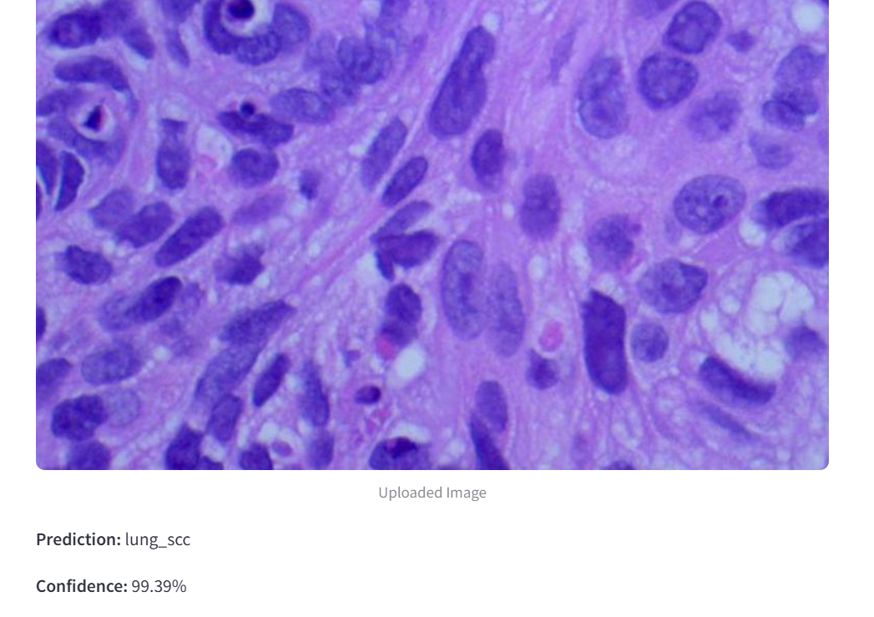
Model deployment
https://cancer-detection-kisv9qetappzv5imvkwed4r.streamlit.app/

Slide 13
References
Piyush Kashyap. (2023). Transfer learning in PyTorch: Fine-tuning pre-trained models for custom datasets. Medium. Retrieved from: https://medium.com/@piyushkashyap045/transfer-learning-in-pytorch-fine-tuning-pretrained-models-for-custom-datasets-6737b03d6fa2
Rahaman MM, Millar E , Meijering E, (2024) Generalized deep learning for histopathology image classification using supervised contrastive learning. Journal of Advanced Research. Retrieved from: https://www.sciencedirect.com/science/article/pii/S2090123224005320
Paper with Code. (n.d.). LC25000(Lung and Colon Histopathological Image Dataset).Retrieved from: https://paperswithcode.com/dataset/lc25000#:~:text=LC25000%20(Lung%20And%20Colon%20Histopathological%20Image%20Dataset)&text=The%20LC25000%20dataset%20contains%2025%2C000,carcinomas%20and%20bening%20lung%20tissues.
Daniyal M. (2023). Pre-train CNN architectures: designs, performance analysis and comparison. Medium. Retrieved from: https://medium.com/@daniyalmasoodai/pre-train-cnn-architectures-designs-performance-analysis-and-comparison-802228a5ce92
WHO.(2024, January2). 2024 global cancer burden growing amidst mounting need for services. World Health Organization. https://www.who.int/news/item/01-02-2024-global-cancer-burden-growing--amidst-mounting-need-for-services#:~:text=Lung%20cancer%20was%20the%20leading,660%20000%20deaths%2C%206.8%25).
Borkowski AA, Bui MM, Thomas LB, Wilson CP, DeLand LA, Mastorides SM. Lung and Colon Cancer Histopathological Image Dataset (LC25000). arXiv:1912.12142v1 [eess.IV], 2019

Slide 14

Email: evat960@gmail.com
GitHub: https://github.com/evetanyiting
LinkedIn: https://www.linkedin.com/in/eva-yiting-tan-b1a67a338/

